Slide 1
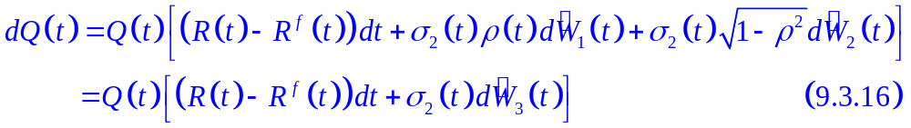

9.3.4 Siegel’s Exchange Rate Paradox
In (9.3.16), the mean rate of change for the exchange rate Q(t) is R(t) - R^{f}(t) under the domestic risk-neutral measure .
From the foreign perspective, the exchange rate is 1/Q(t), and one should expect the mean rate of change of 1/Q(t) to be R^{f}(t) - R(t).
This turns out not to be as straight forward as one might expect because of the convexity of the function f(x) = 1/x.

Slide 2
Example:
Exchange rate of 0.9 euros to the dollar:
1 euro → 1.1111 dollars
If the dollar price of euro falls by 5%:
1 euro → 0.95 × 1.1111 = 1.0556 dollars
This is an exchange rate of 1/1.0556=0.9474 euros to dollars. The change from 0.9 euros to the dollar to 0.9474 euros to the dollar is a 5.26% ( = 1/0.95 - 1) increase in the euro price of the dollar, not a 5% increase.

Slide 3
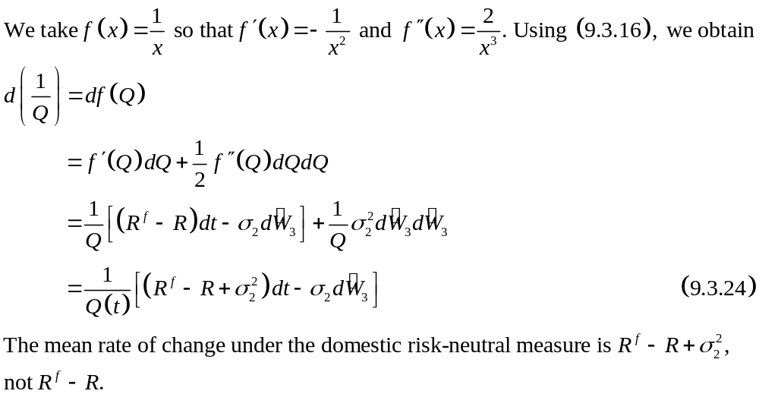

Slide 4
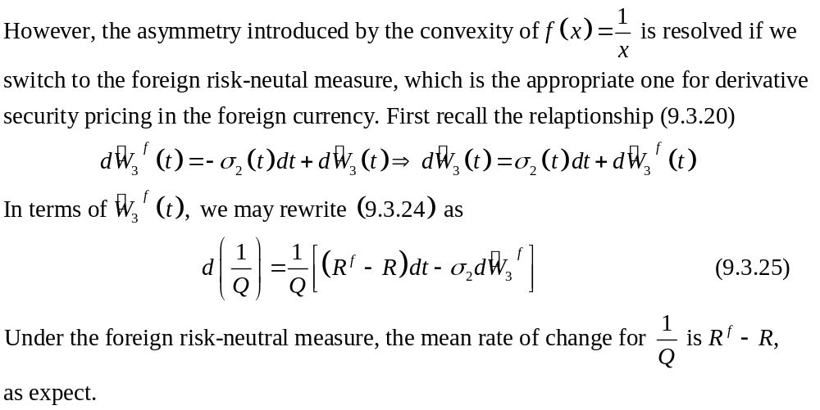

Slide 5
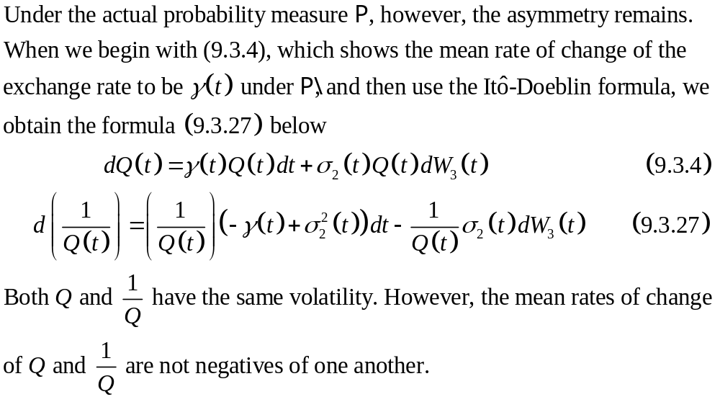

Slide 6
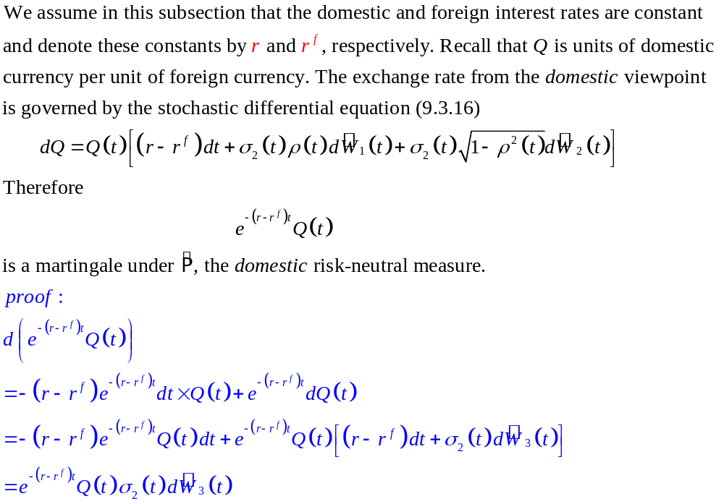
9.3.5 Forward Exchange Rates
國外 money market account 用國內 money market account 計價

Slide 7
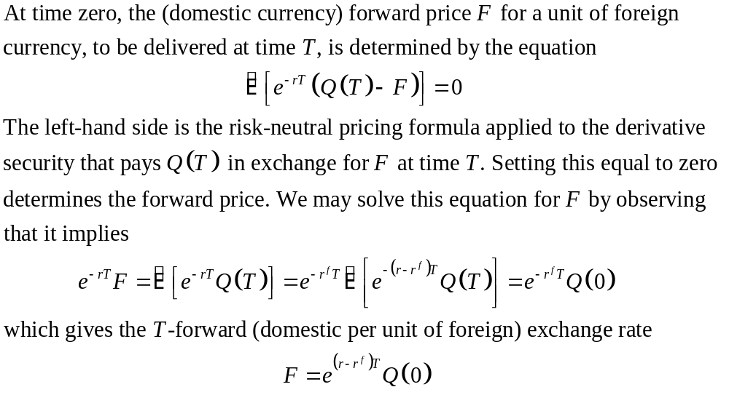

Slide 8
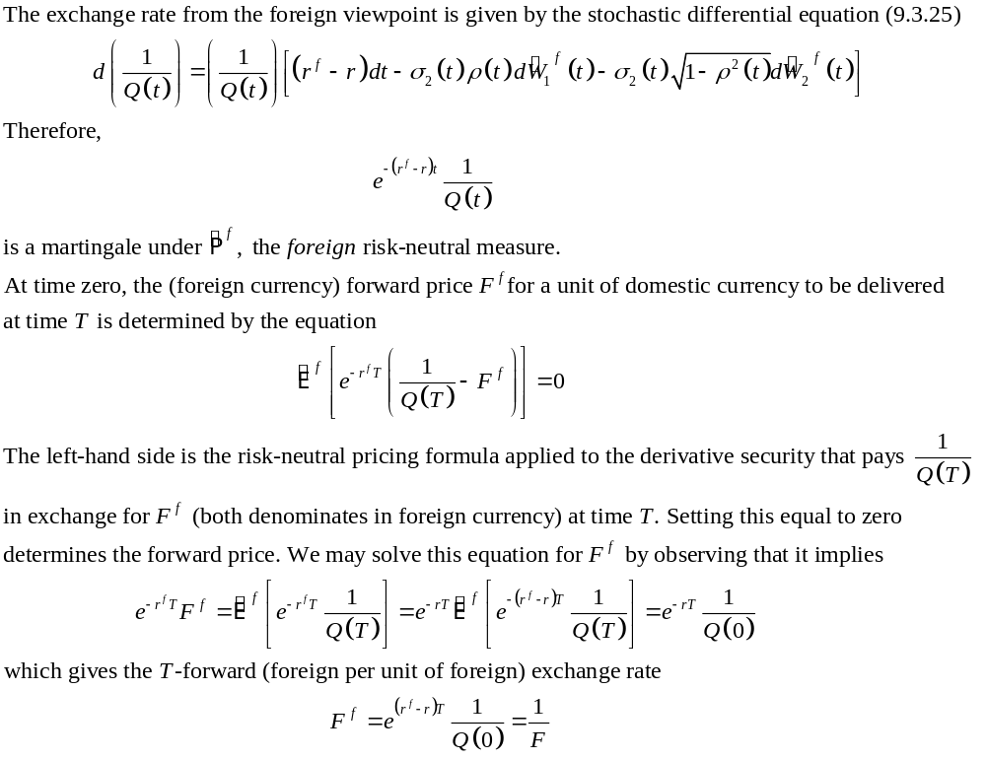

Slide 9
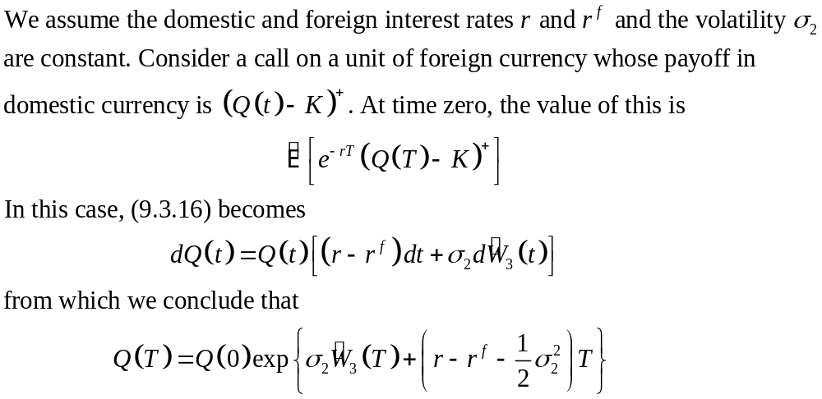
9.3.6 Garman-Kohlhagen Formula

Slide 10
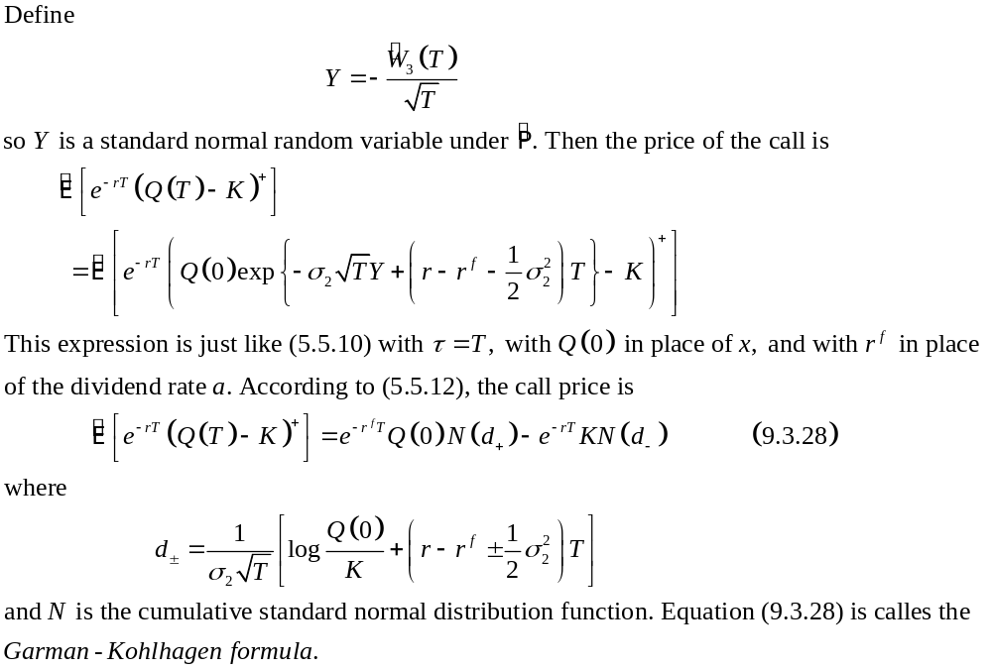
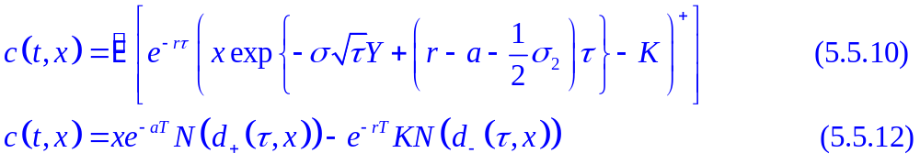

Slide 11
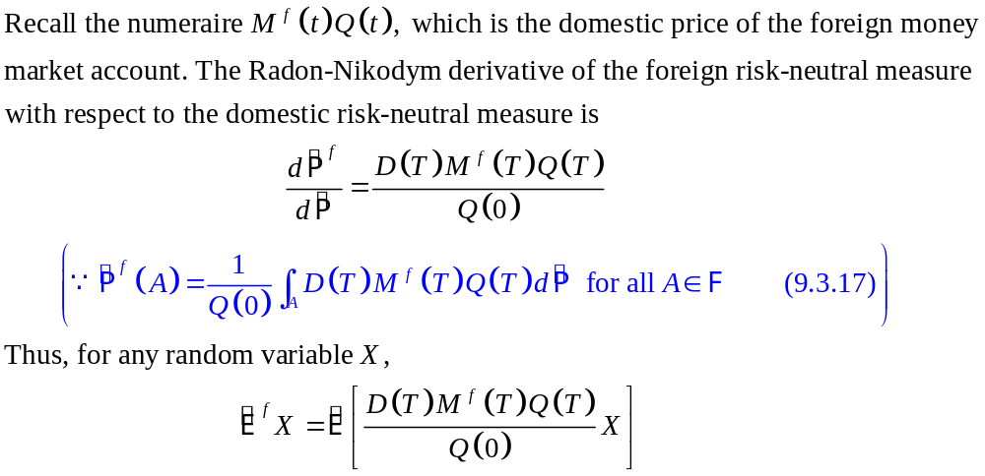
9.3.7 Exchange Rate Put-Call Duality

Slide 12
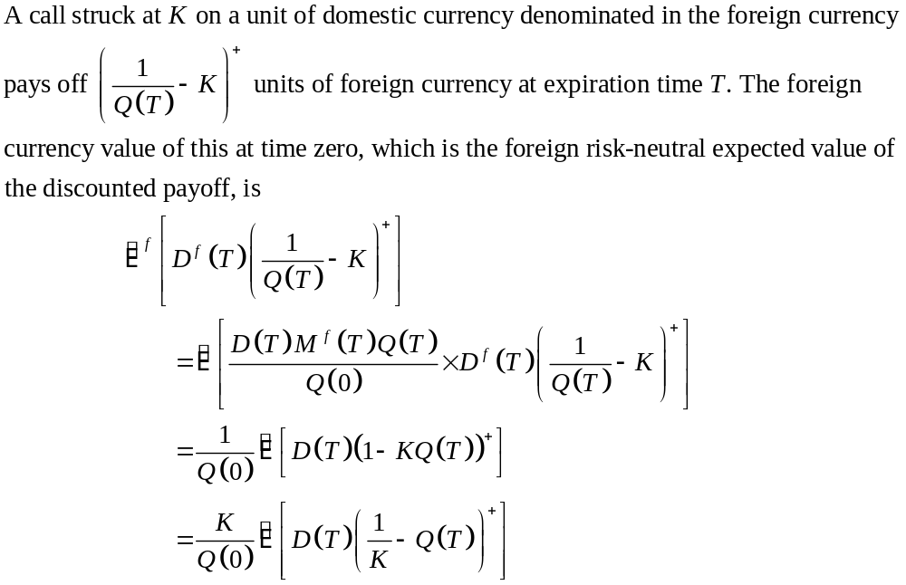

Slide 13
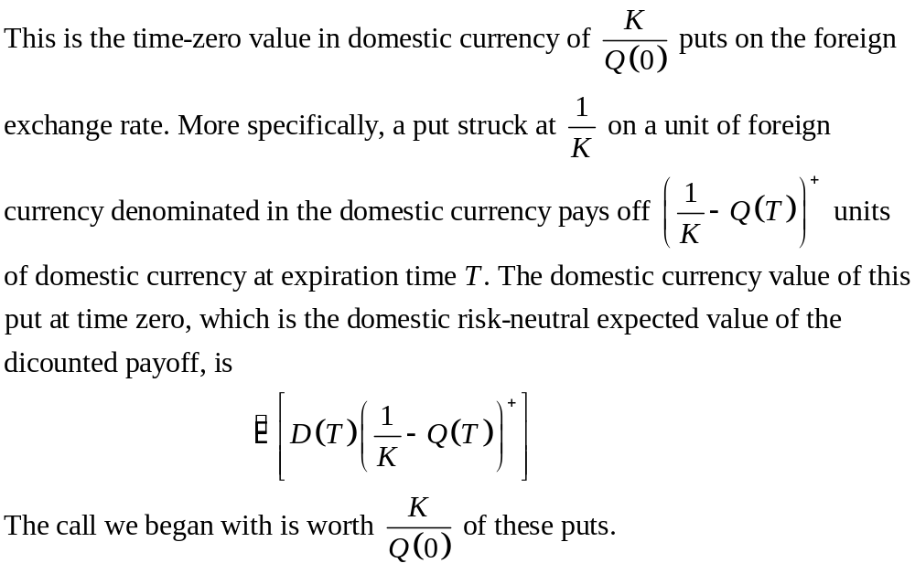

Slide 14
